Slide 1

Web Hacking and Exploitation
教育部資訊安全人才培育計畫
資安實務專題講座
CTF搶旗大賽的重要資安實務技術
曾龍
btseng@mail.ksu.edu.tw
崑山科技大學
資工系暨數位生活科技研究所 副教授
雲端大數據分析暨資通安全研發中心 主任

Slide 2
網站安全分析工具
Tools

Slide 3


有一堆WebSecurity Tools➔藍色部分(必教)
工具 | 上課 | 學生練習
Browser plugins | Developer tools | Tamper data, ………..
web proxy|web debugger | Burp Suite | ZAP Fiddler Websracab
Command line Tool | CURL
Automatic SQLi Tools | Sqlmap | Pagolin Havij PySQLi sqlinjector
Automatic XSS scanner | OWASP Xenotix XSS Exploit Framework v5 | XSSer XSSF xsspy Damn Small XSS Scanner
Security scanner | W3af WIKTO | OPENVAS Grabber Wapiti Ratproxy Arachni
當然還有寫python程式
下次有時間再來分享
XSSer (v1.7.1 "Zika") has been added to Kali Linux (2016)
https://github.com/sempervictus/xssf
https://github.com/faizann24/XssPy
Damn Small XSS Scanner (DSXS) is a fully functional Cross-site scripting vulnerability scanner (supporting GET and POST parameters) written in under 100 lines of code.
14 Best Open Source Web Application Vulnerability Scanners
http://resources.infosecinstitute.com/14-popular-web-application-vulnerability-scanners/

Slide 4
Browser’s plugins
Developer Tools
瀏覽器有許多內建功能及plugins
本課程示範使用最有名的Developer Tools 【開發者工具】

Slide 5
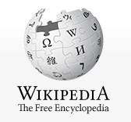
Web development tools https://en.wikipedia.org/wiki/Web_development_tools
Web development tools allow web developers to test and debug their code.
They are different from website builders and integrated development environments (IDEs) in that they do not assist in the direct creation of a webpage, rather they are tools used for testing the user interface of a website or web application.
Web development tools come as browser add-ons or built-in features in web browsers.
The most popular web browsers today, Google Chrome, Firefox, Opera, Internet Explorer, UC browser and Safari, have built-in tools to help web developers, and many additional add-ons can be found in their respective plugin download centers.
Web development tools allow developers to work with a variety of web technologies, including HTML, CSS, the DOM, JavaScript, and other components that are handled by the web browser.
Due to increasing demand from web browsers to do more, popular web browsers have included more features geared for developers.

Slide 6
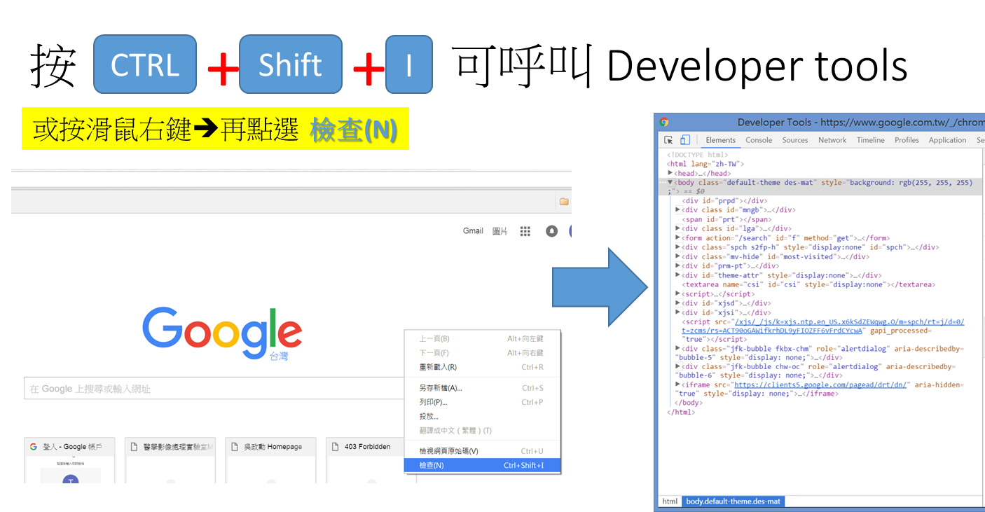

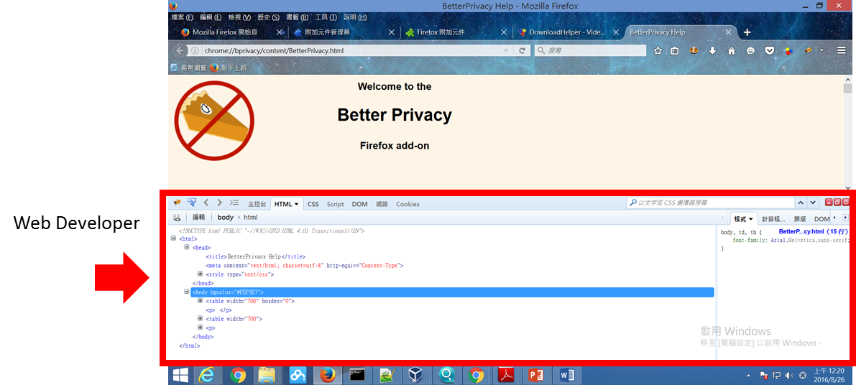
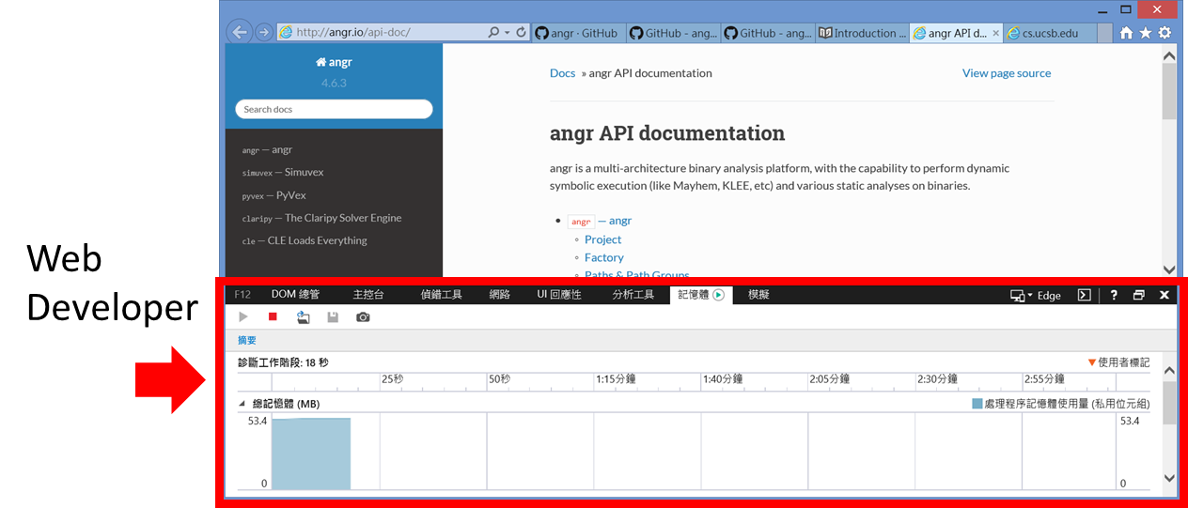
Web developer tools support
browser | tools
Google Chrome | Web Developer Tools
Internet Explorer | F12 Web Developer Tools
Safari | Safari Web Development Tools
Firefox | F12 Web Console / Browser Console
Opera | Opera Dragonfly

Slide 7
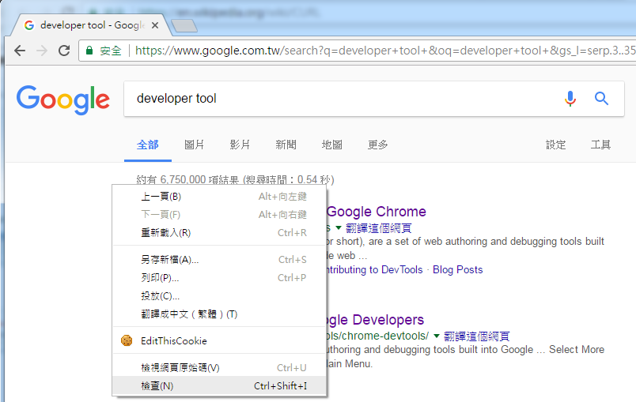
打開你的 Developer Tools https://developers.google.com/web/tools/chrome-devtools/
右鍵->檢查

Slide 8
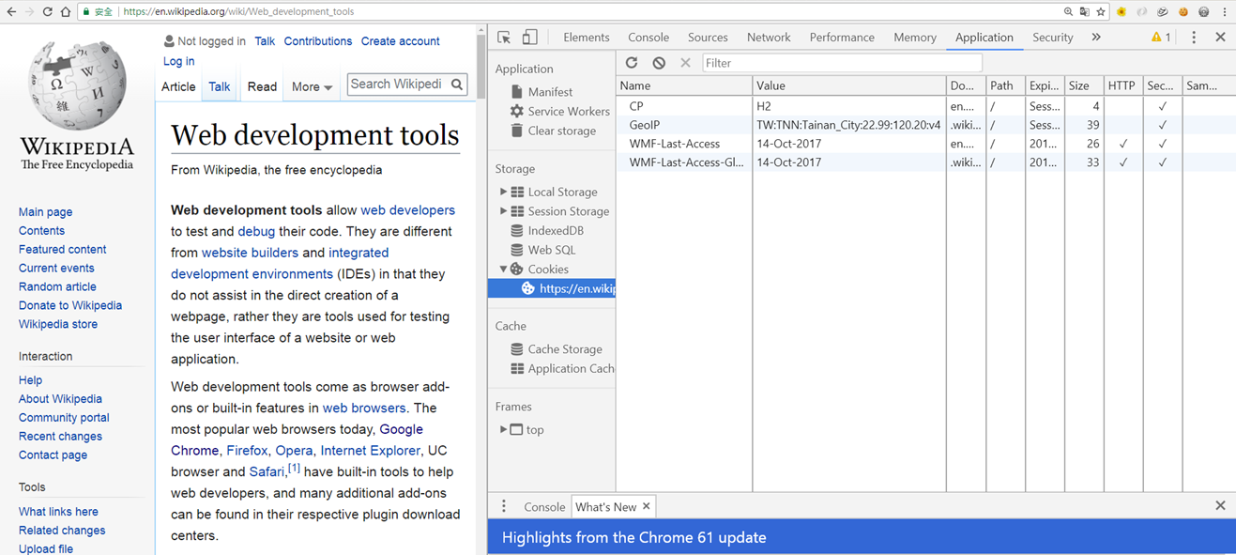
Developer Tools for Chrome https://developers.google.com/web/tools/chrome-devtools/

Slide 9
Developer Tools for Chrome https://developers.google.com/web/tools/chrome-devtools/
panels
Elements panel | Iterate on the layout and design of your site by freely manipulating the DOM and CSS.
Console panel | Log diagnostic information during development or interact with the JavaScript on the page.
Sources panel | Debug your JavaScript using breakpoints or connect your local files via Workspaces to use DevTools as a code editor.
Network panel | Optimize page load performance and debug request issues.
Performance panel | Improve the runtime performance of your page by recording and exploring the various events that happen during the lifecycle of a site.
Memory panel | Profile memory usage and track down leaks.
Application panel | Inspect all resources that are loaded, including IndexedDB or Web SQL databases, local and session storage, cookies, Application Cache, images, fonts, and stylesheets.
Security panel | Debug mixed content issues, certificate problems, and more.

Slide 10
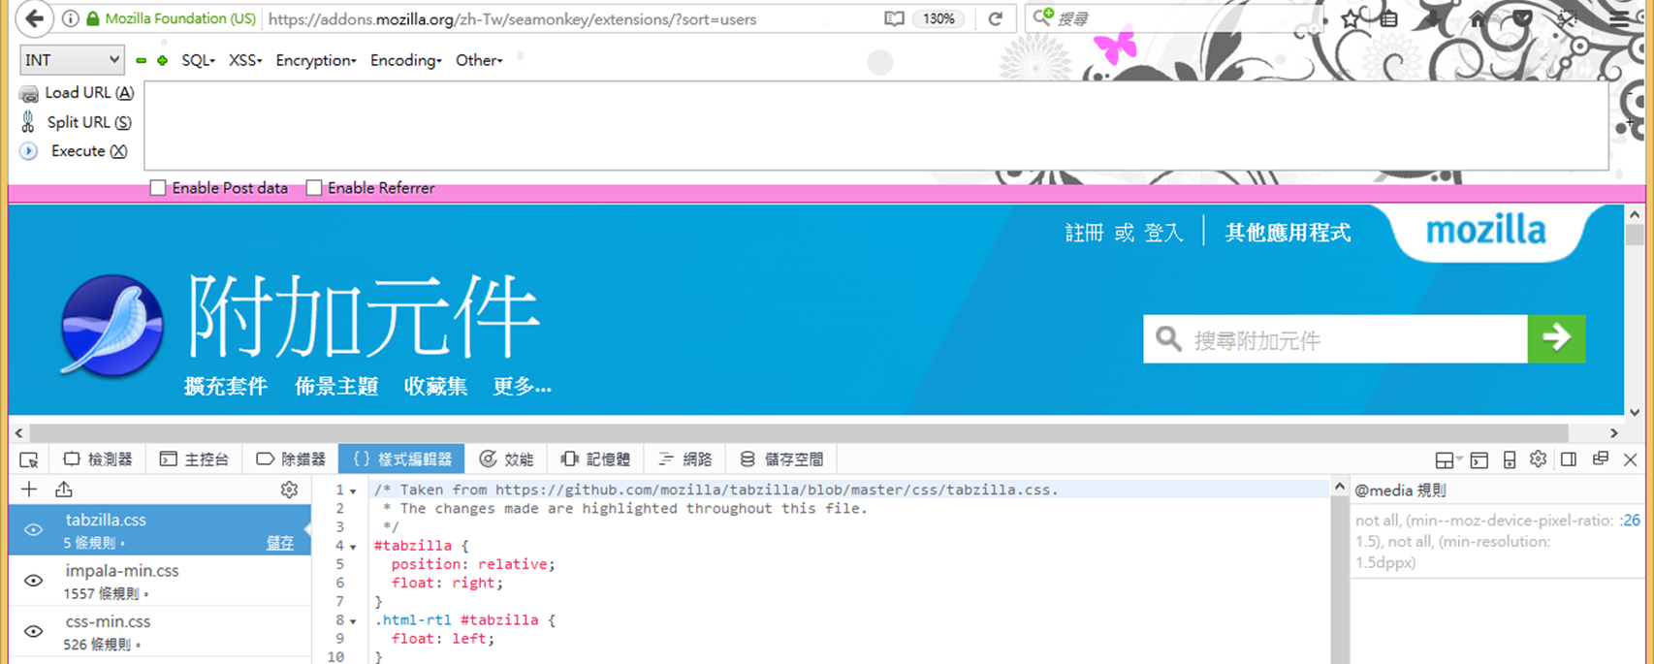

Developer Tools for Firefox https://developer.mozilla.org/en-US/docs/Tools
Core Tools核心工具 | 敘述
Page Inspector | View and edit page content and layout. Visualise many aspects of the page including the box model, animations, and grid layouts.
Web Console | See messages logged by a web page and interact with the page using JavaScript.
JavaScript Debugger | Stop, step through, examine, and modify the JavaScript running in a page.
Network Monitor | See the network requests made when a page is loaded.
Performance Tools | Analyze your site's general responsiveness, JavaScript, and layout performance.
Responsive Design Mode | See how your website or app will look and behave on different devices and network types.

Slide 11
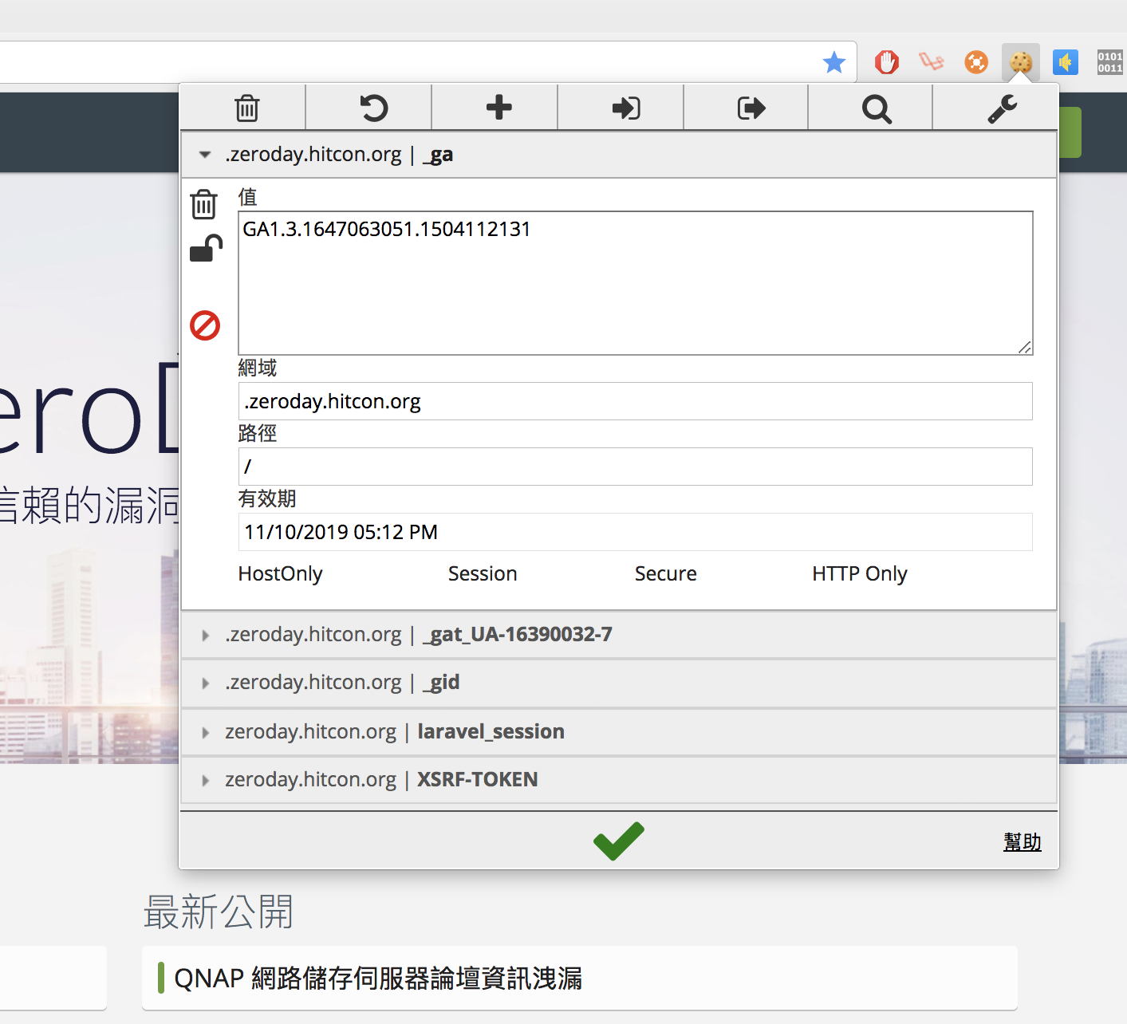
EditThisCookie ( for chrome )
https://chrome.google.com/webstore/detail/editthiscookie/fngmhnnpilhplaeedifhccceomclgfbg?hl=zh-TW
輕鬆的編輯修改 cookie
EditThisCookie 是一個 cookie 管理器。您可以增加、刪除、修改、搜尋、保護和封鎖 cookies！
Inspired by the lack of a good cookie manager in google chrome i developed this small simple and extremely useful extension, that let's you perform anything you might actually need to do with cookies
★ Delete any cookie
★ Edit any cookie
★ Add a new cookie
★ Search a cookie
★ Protect a cookie (read-only)
★ Block cookies (cookie filter)
★ Export cookies in JSON, Netscape cookie file (perfect for wget and curl), Perl::LPW
★ Import cookies in JSON
★ Limit the maximum expiration date of any cookie

Slide 12
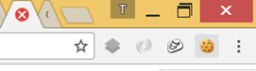
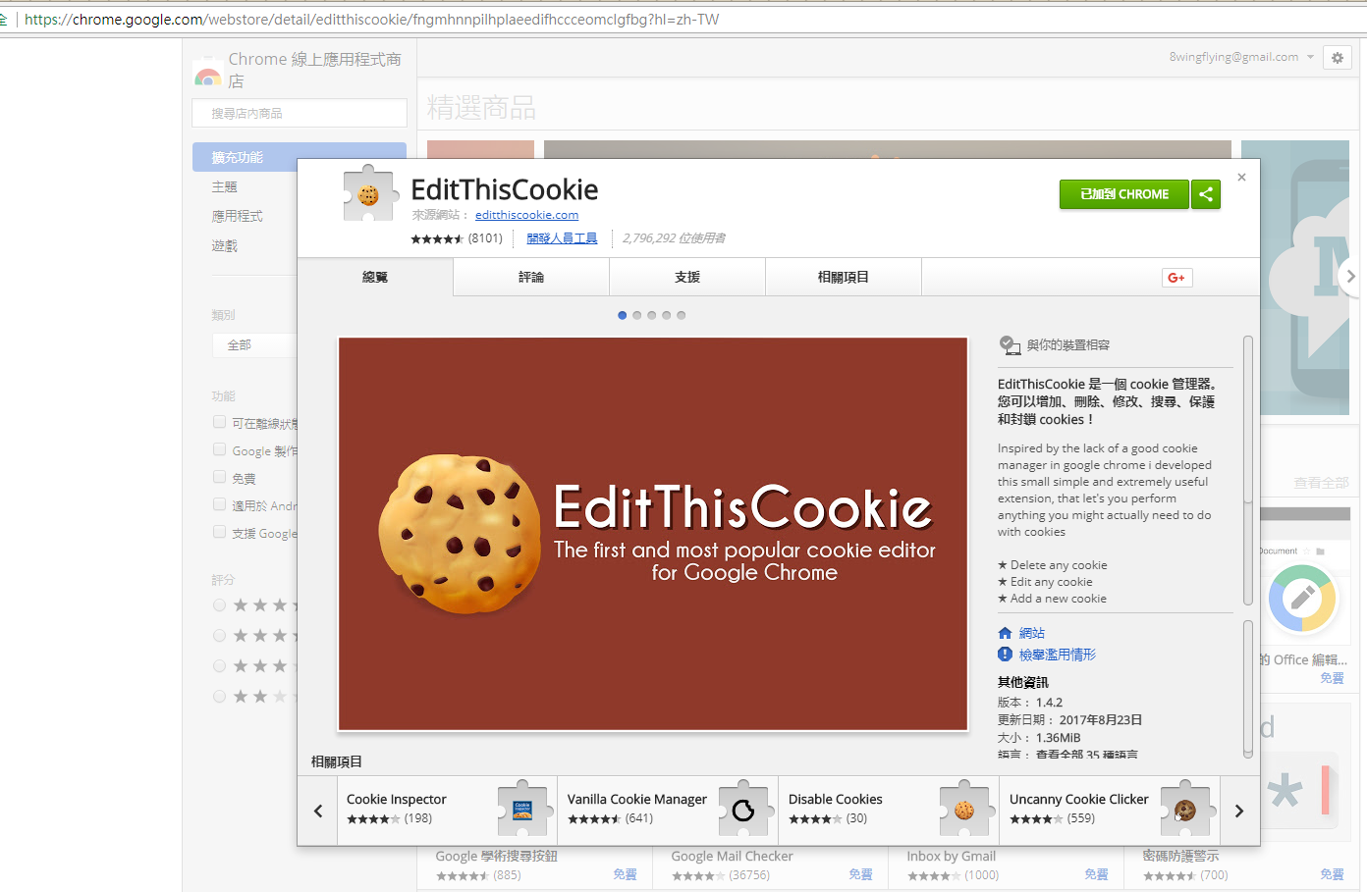
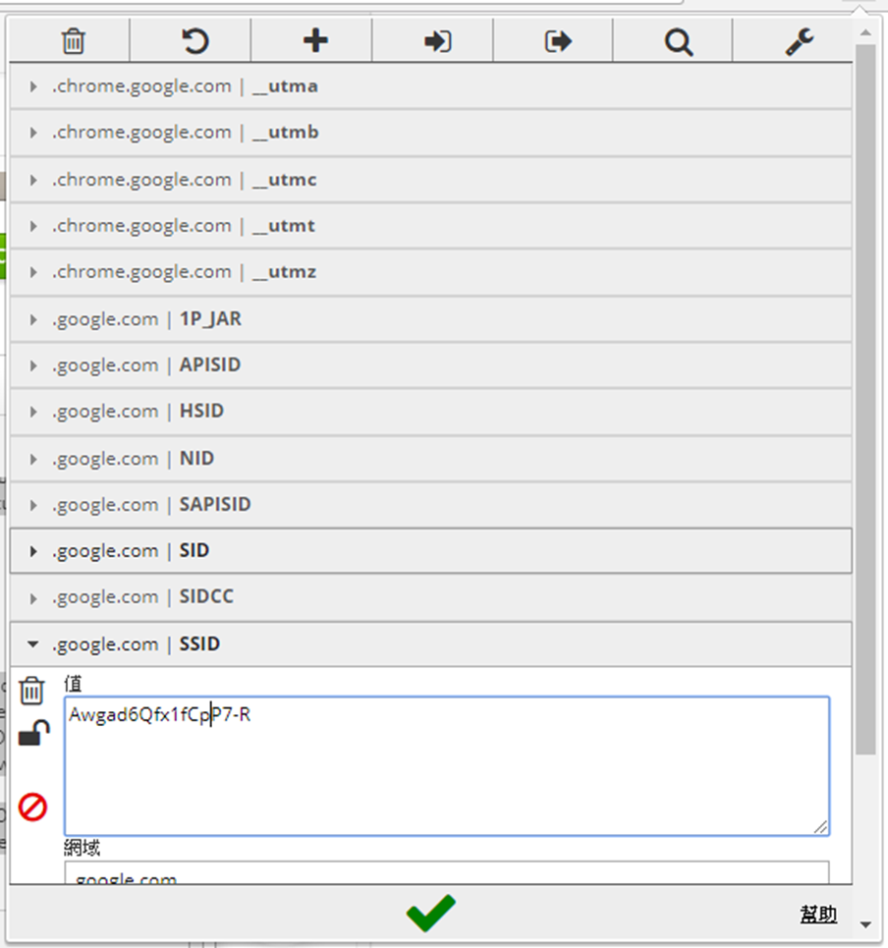
EditThisCookie ( for chrome )
到此網址 https://chrome.google.com/webstore/detail/editthiscookie/fngmhnnpilhplaeedifhccceomclgfbg?hl=zh-TW

Slide 13
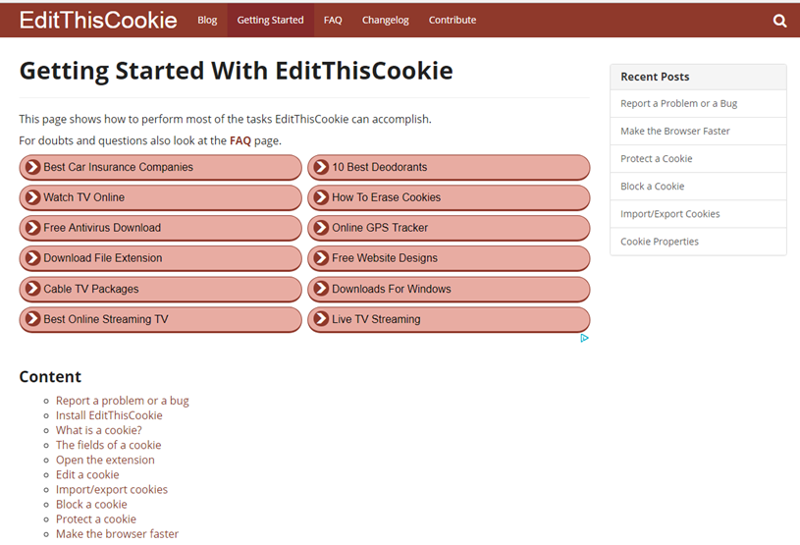
練習看看 記得做簡報
http://www.editthiscookie.com/start/

Slide 14
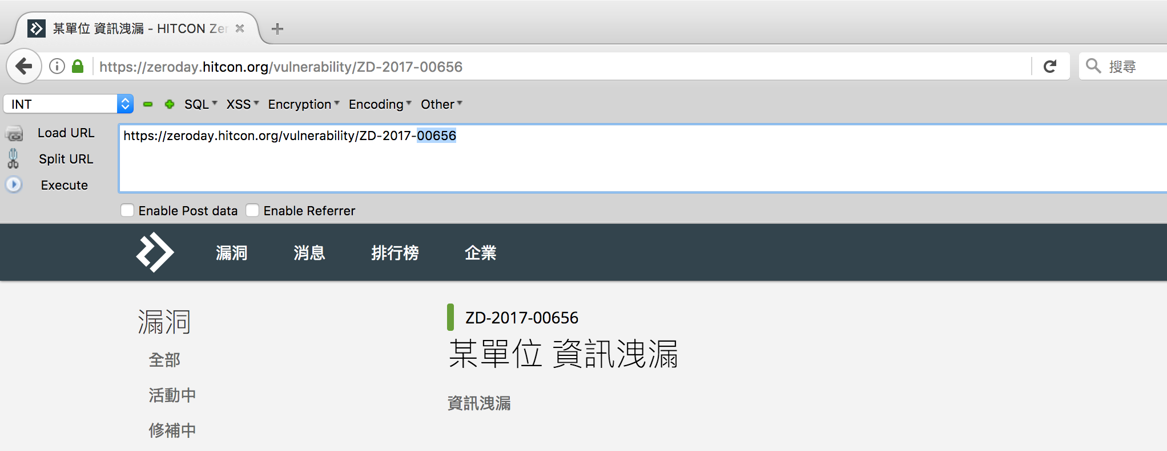
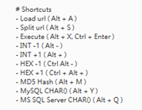
Hackbar ( for firefox ) [須留意是否支援最新版本的瀏覽器]
https://chrome.google.com/webstore/detail/wappalyzer/gppongmhjkpfnbhagpmjfkannfbllamg?hl=zh-TW
將 URL 上框選的數字加一減一
並即時更新頁面(可拿來 iterate 分頁)
常見的加解密和常見的 payload
編輯 URL 的區域

Slide 15
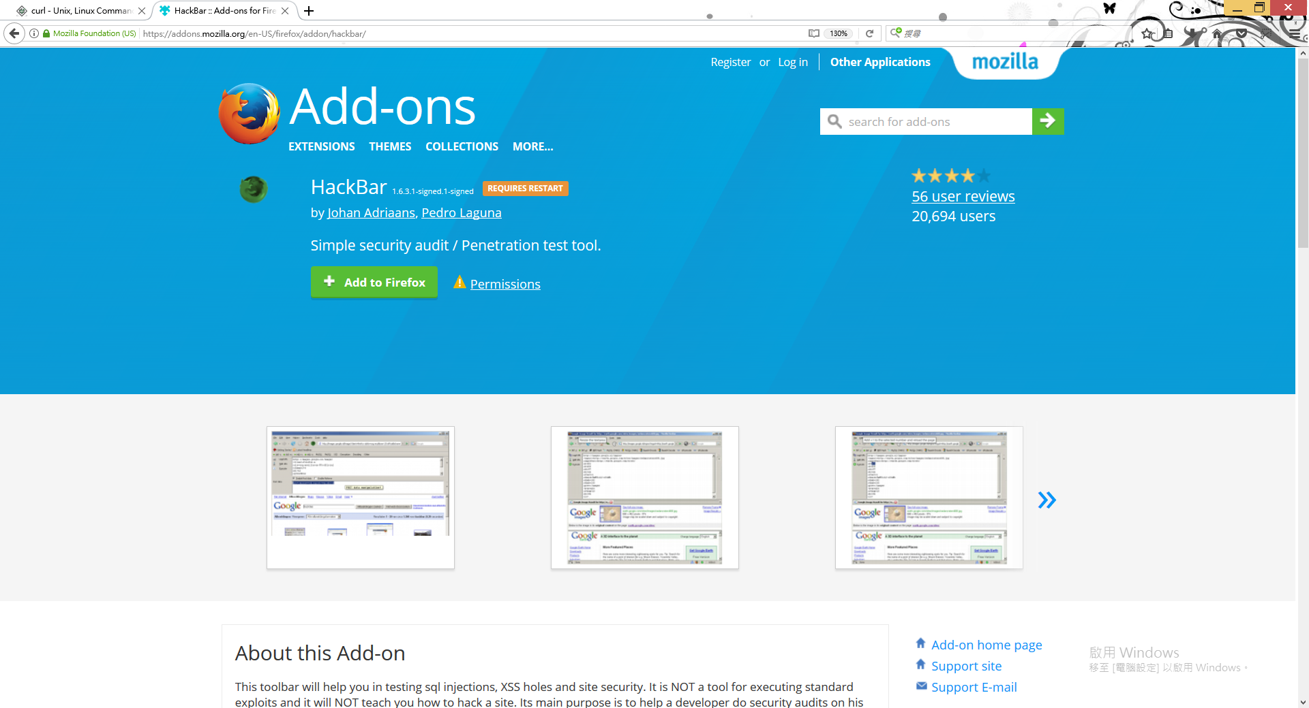
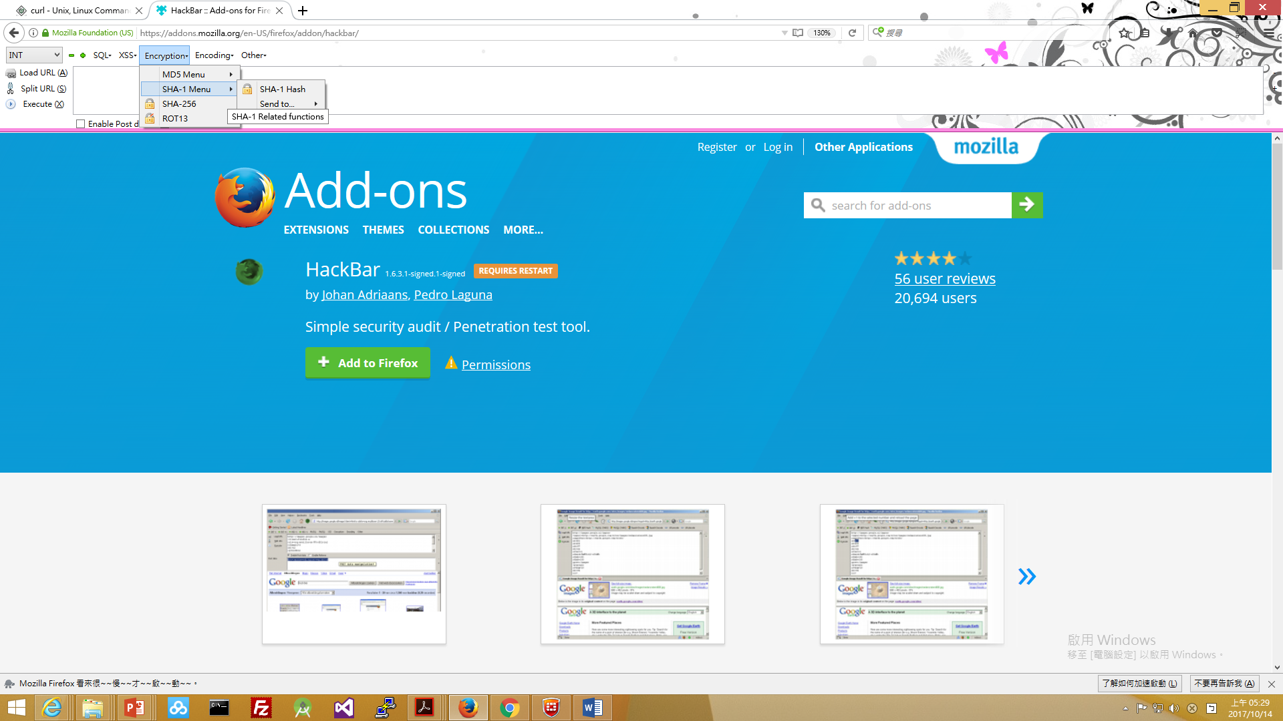
https://addons.mozilla.org/en-US/firefox/addon/hackbar/
Hackbar ( for firefox ):安裝篇
點選後➔
再重啟動

Slide 16
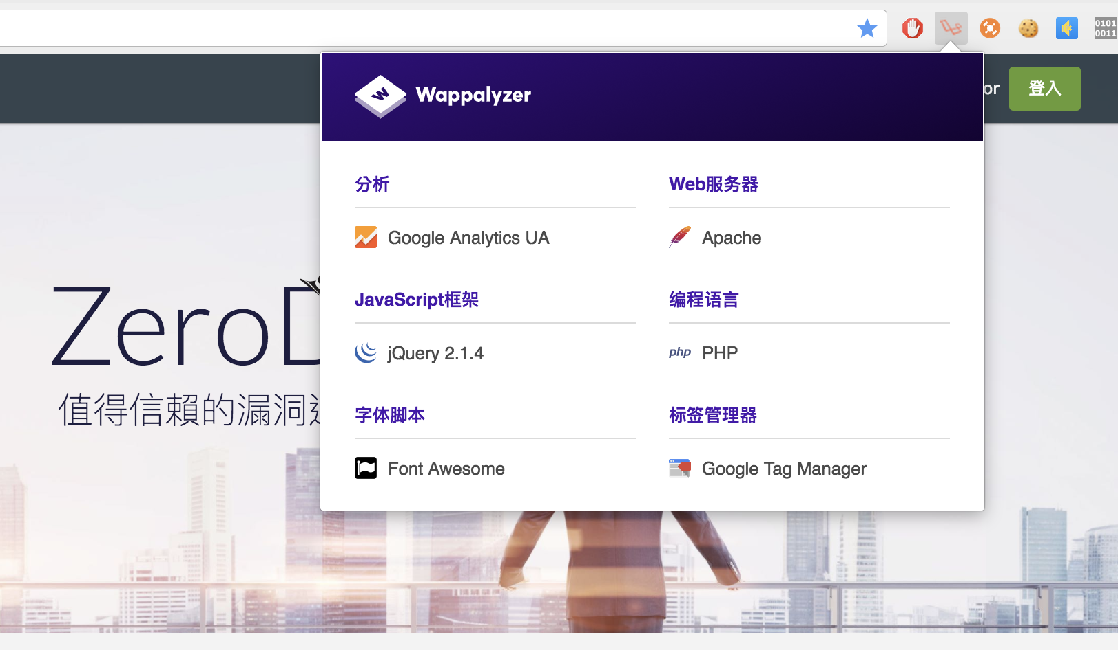
Wappalyzer ( for chrome ) 就請自我練習
https://chrome.google.com/webstore/detail/wappalyzer/gppongmhjkpfnbhagpmjfkannfbllamg?hl=zh-TW
伺服器所使用的
框架,語言的訊息

Slide 17
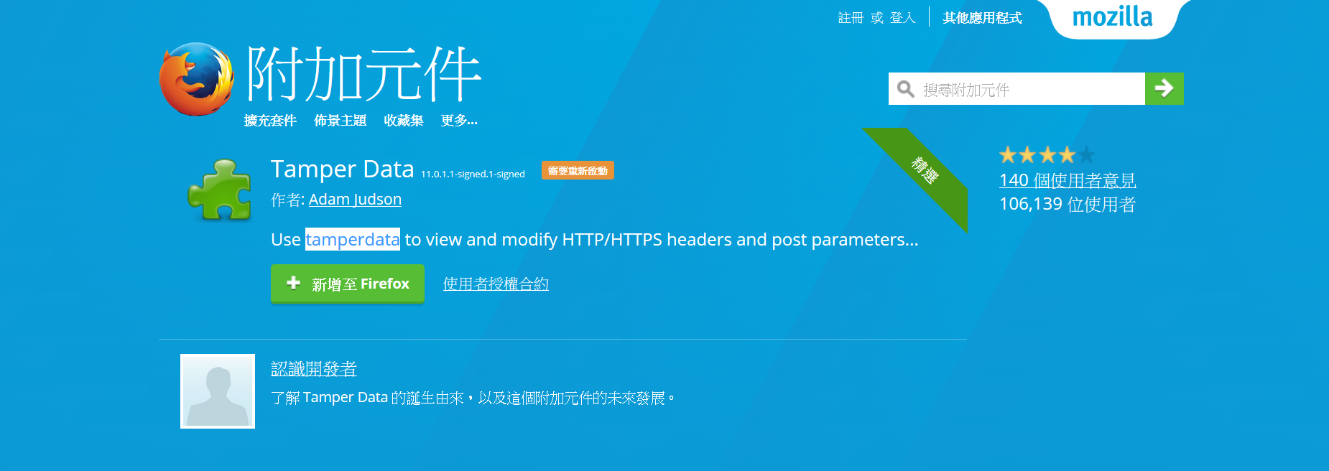
學生作業: Tamper Data測試報告
https://addons.mozilla.org/zh-tw/firefox/addon/tamper-data/
作業要點:
1.自行上網搜尋相關教學解說資料(slideshare, youtube, google)
2.要有自己的測試心得(若有參考別人的測試需註明引用來源)
3.格式:PPT(自己要分享的簡報)+word(格式可參考所附範本)

Slide 18
Burpsuite

Slide 19
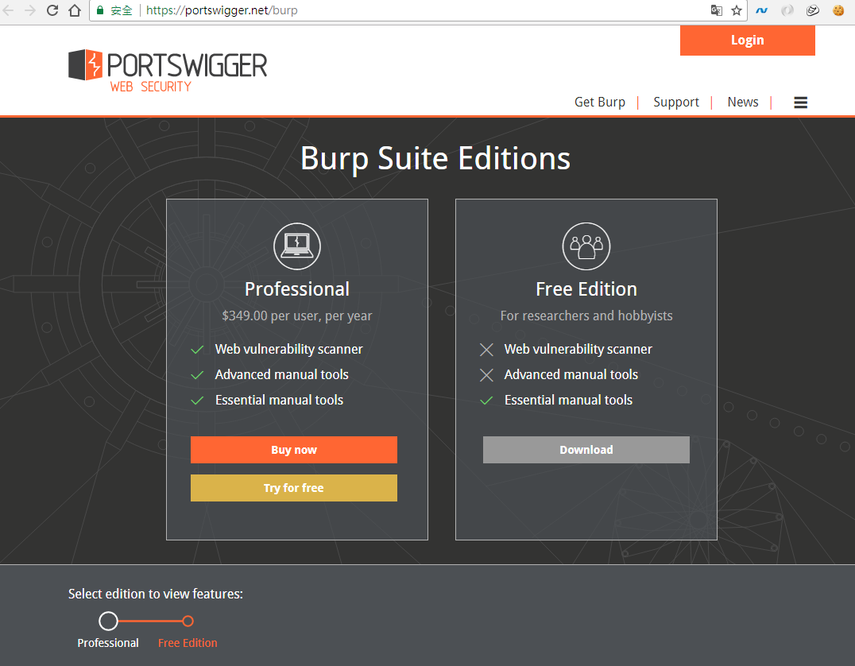

Burp Suite https://en.wikipedia.org/wiki/Burp_suite
官方網址 https://portswigger.net/
Burp Suite is a graphical tool for testing Web application security.
The tool is written in Java and developed by PortSwigger Security.
The tool has 2 versions:
Free version that can be downloaded free of charge(Free Edition)
Full version that can be purchased after a trial period (Professional Edition).

Slide 20
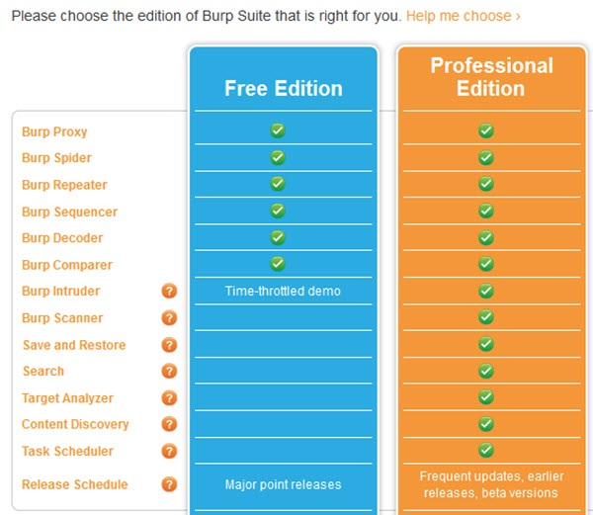

Slide 21
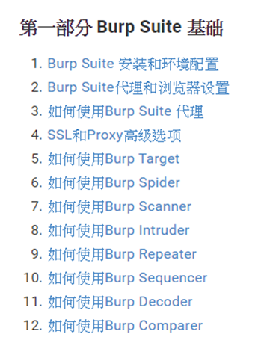
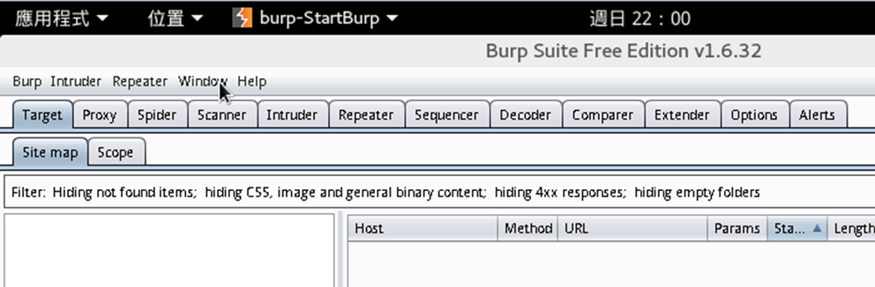
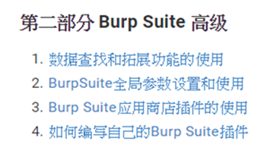
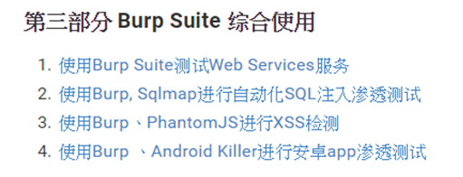
burpsuite實戰指南 https://t0data.gitbooks.io/burpsuite/content/

Slide 22
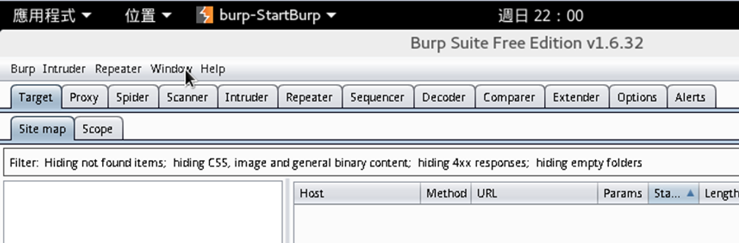
Burp suite::tools https://portswigger.net/burp/help/suite_burptools.html
tools | Description
Target | This tool contains detailed information about your target applications, and lets you drive the process of testing for vulnerabilities.
Proxy | This is an intercepting web proxy that operates as a man-in-the-middle between the end browser and the target web application. It lets you intercept, inspect and modify the raw traffic passing in both directions.
Spider | This is an intelligent application-aware web spider that can crawl an application to locate its content and functionality.
Scanner [Pro version] | This is an advanced web vulnerability scanner, which can automatically discover numerous types of vulnerabilities.
Intruder | This is a powerful tool for carrying out automated customized attacks against web applications. It is highly configurable and can be used to perform a wide range of tasks to make your testing faster and more effective.
Repeater | This is a simple tool for manually manipulating and reissuing individual HTTP requests, and analyzing the application's responses.
Sequencer | This is a sophisticated tool for analyzing the quality of randomness in an application's session tokens or other important data items that are intended to be unpredictable.
Decoder | This is a useful tool for performing manual or intelligent decoding and encoding of application data.
Comparer | This is a handy utility for performing a visual "diff" between any two items of data, such as pairs of similar HTTP messages.
Extender | This lets you load Burp extensions, to extend Burp's functionality using your own or third-party code.

Slide 23


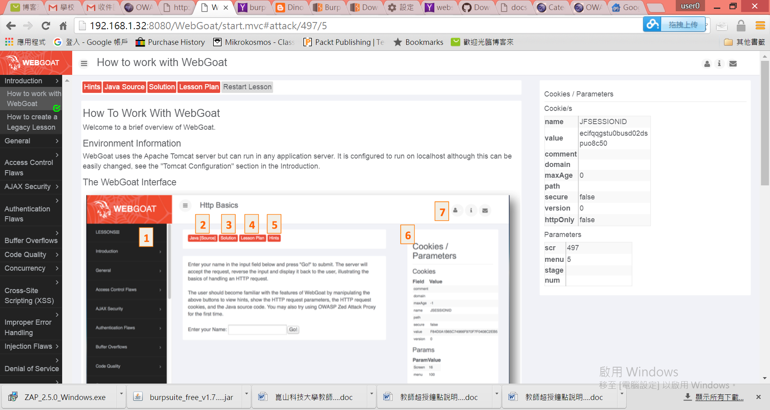





Burp suite:: 強大功能
web proxy|web debugger
Intercept browser traffic using man-in-the-middle proxy
設定與使用方式請參閱DEMO教材
漏洞平台
利用Burp Suite進行暴力破解

Slide 24
CURL

Slide 25

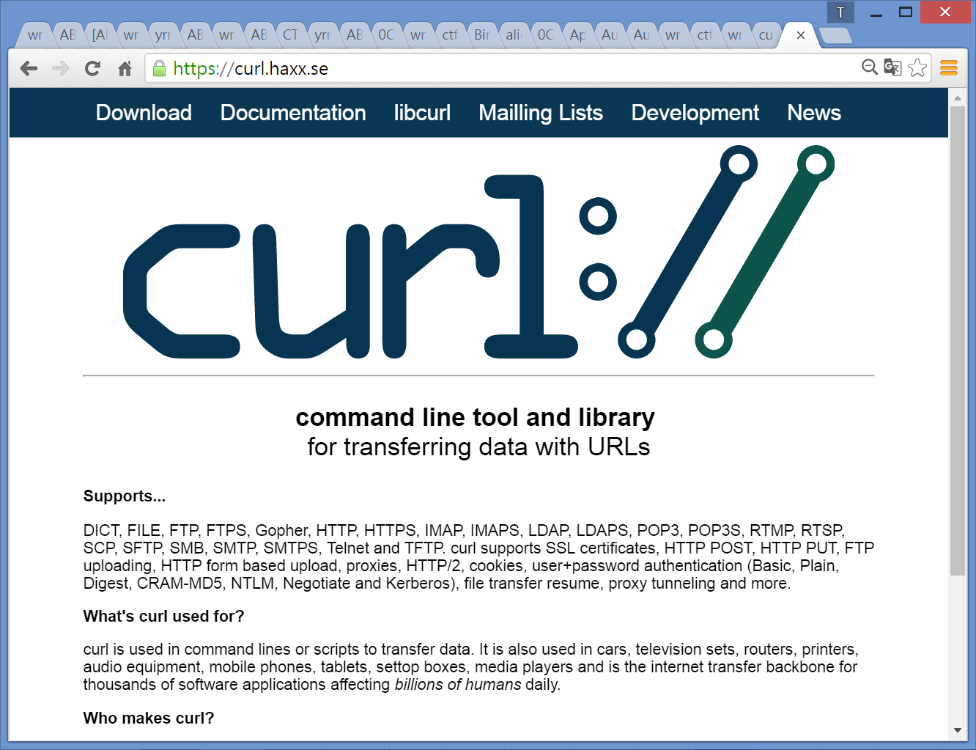
https://github.com/curl/curl
Curl::强大的http命令行工具
https://curl.haxx.se/docs/manpage.html
curl is a tool to transfer data from or to a server.
using one of the supported protocols (DICT, FILE, FTP, FTPS, GOPHER, HTTP, HTTPS, IMAP, IMAPS…etc)
curl offers a busload of useful tricks like proxy support, user authentication, FTP upload, HTTP post, SSL connections…etc
curl is powered by libcurl for all transfer-related features.
https://curl.haxx.se/

Slide 26
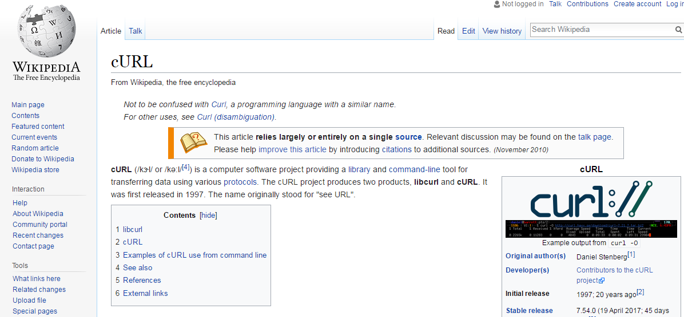
Curl::强大的http命令行工具
https://en.wikipedia.org/wiki/CURL

Slide 27
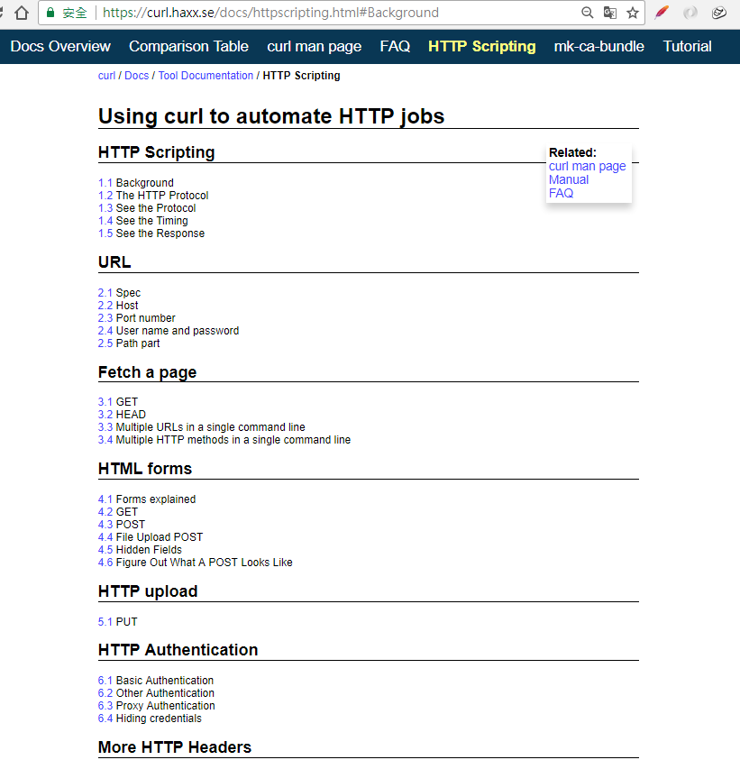
使用 Curl::
https://curl.haxx.se/docs/httpscripting.html#Background
語法格式:: curl [options...] <url>
範例
curl http://www.linuxidc.com | 取得網頁內容，螢幕輸出
curl http://www.linuxidc.com > page.html | 取得網頁內容，存在另一個檔案
curl -o page.html http://www.linuxidc.com | -o: 取得網頁內容，檔案輸出
curl -x 123.45.67.89:1080 -o page.html http://www.linuxidc.com | -x: 指定 http 使用的 proxy
curl -x 123.45.67.89:1080 -o page.html -D cookie0001.txt http://www.linuxidc.com | -D: 把 http response 裡面的 cookie 資訊另存新檔

Slide 28
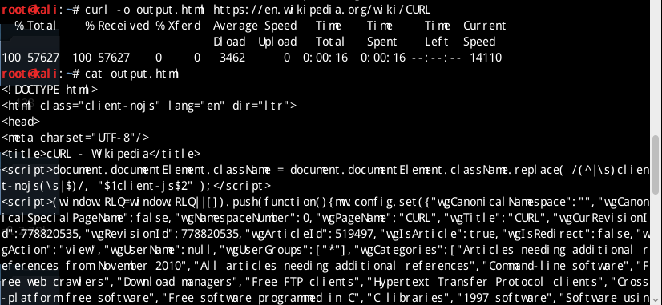
使用範例::Storing downloads https://curl.haxx.se/docs/
curl -o output.html http://example.com/

Slide 29
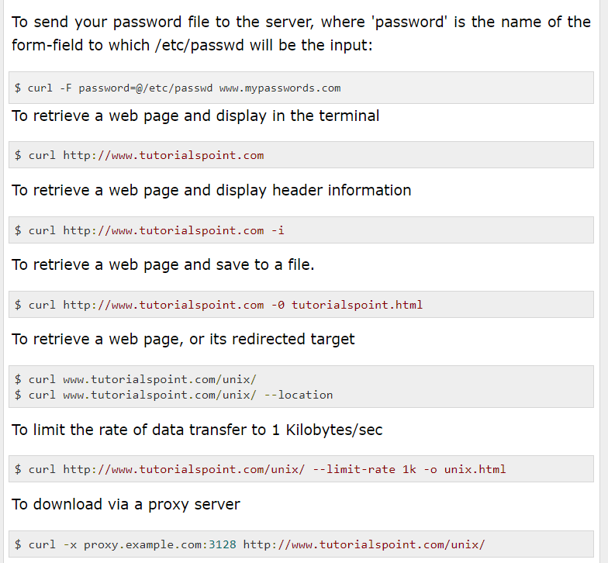
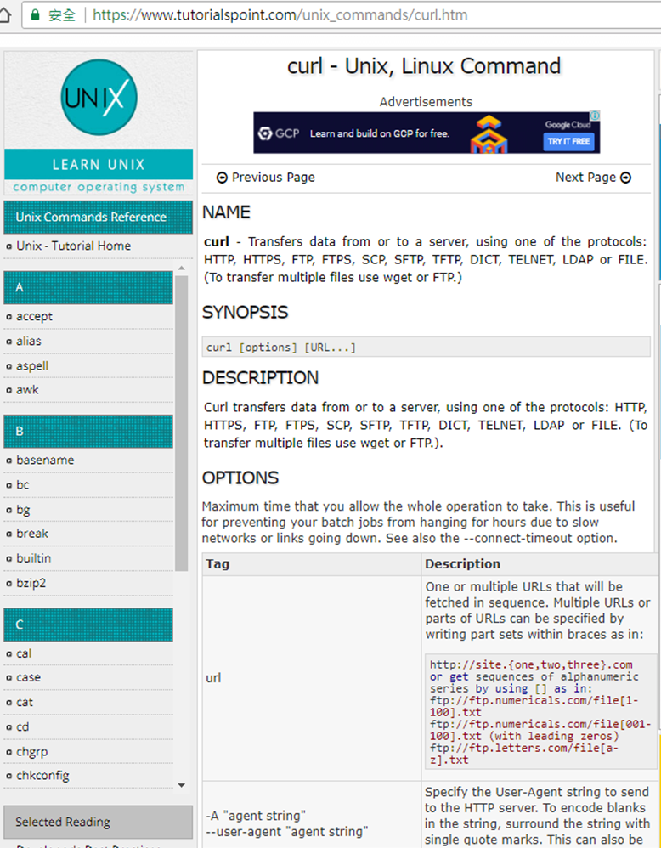
使用 Curl::Curl command
https://www.tutorialspoint.com/unix_commands/curl.htm

Slide 30
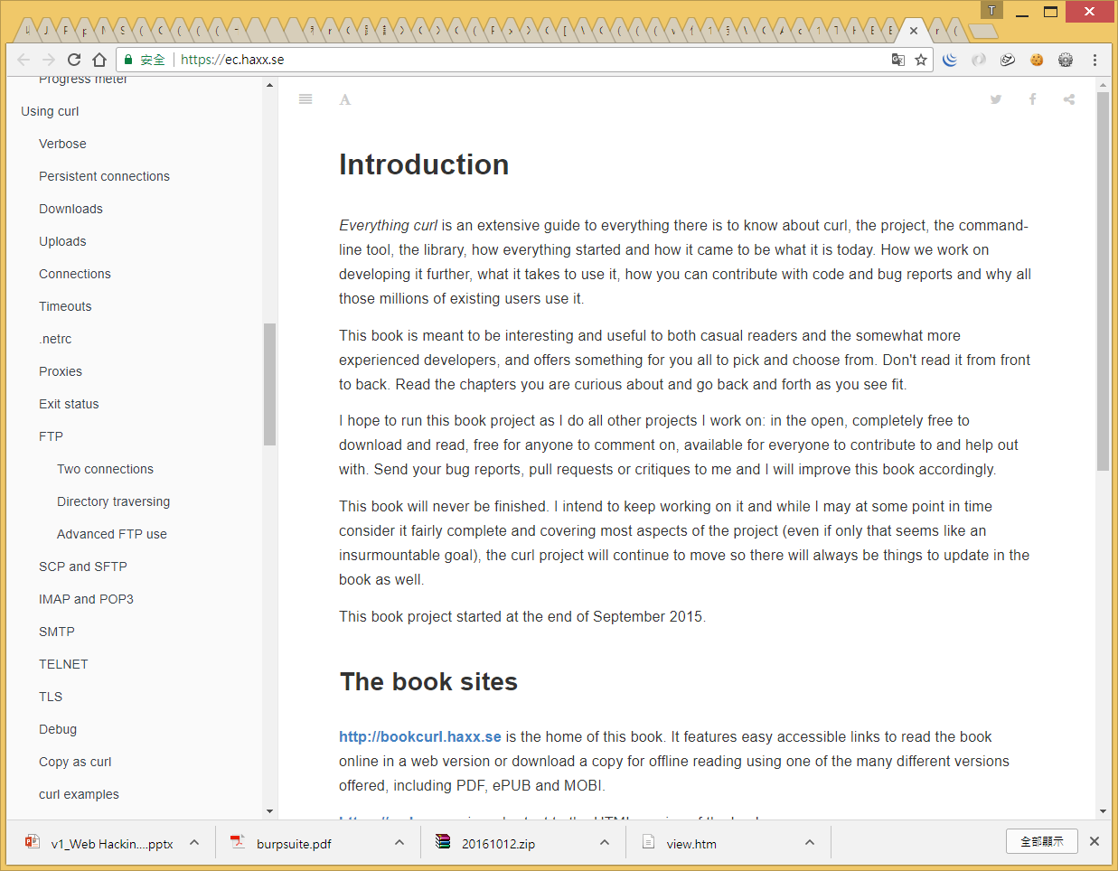
更多訊息 請參閱 Everything curl https://ec.haxx.se/
沒內容➔自己做簡報

Slide 31
Python➔Web XXX
XXX==
Scraping
Penetration testing

Slide 32





Slide 33
